Slide 1
Lego Education EV3
Summit Denali

Slide 2
Demo Day
Goals
Avoid crashes
Stay in the playpen
Move continuously
Learn & have fun!

Slide 3
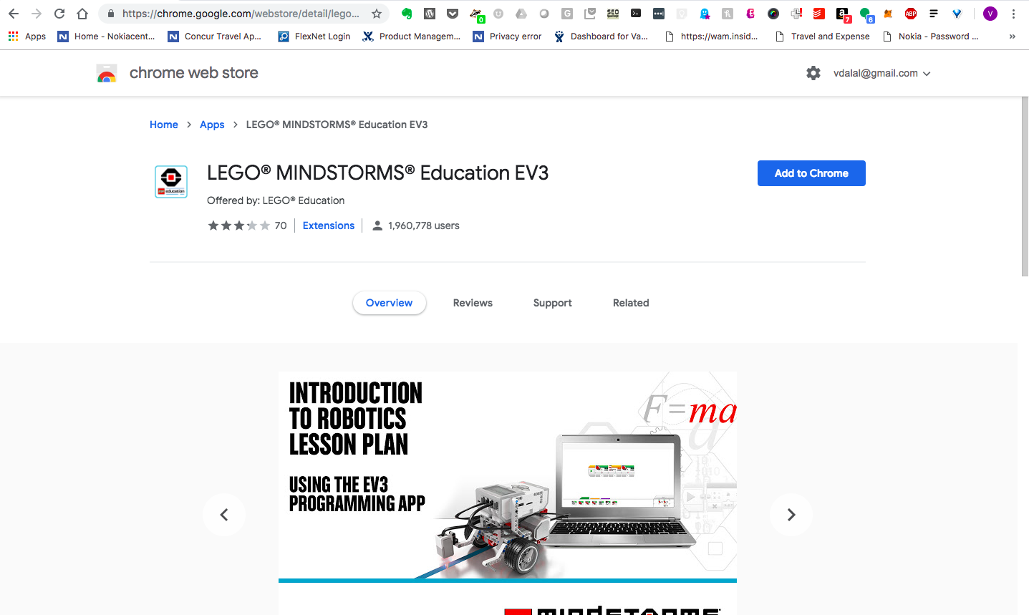
Chrome Web Store

Slide 4
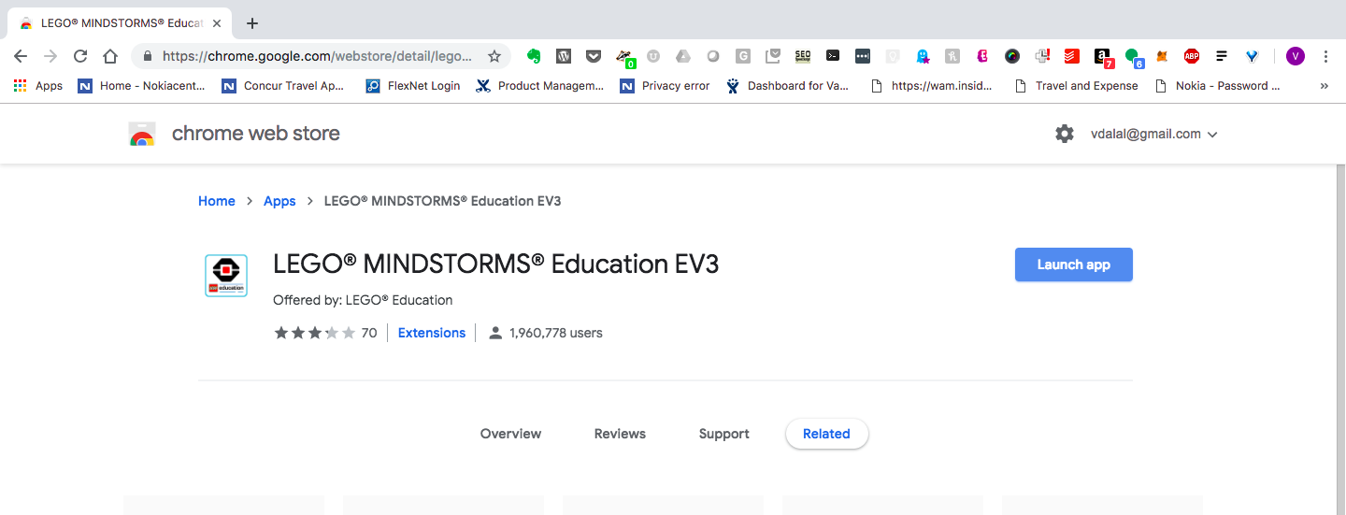
Launch App

Slide 5
FAQ
https://le-www-live-s.legocdn.com/sc/media/files/primary/engb%20campaign%20middle%20school%20ev3%20chromebooks%20faqs-80bbd7d15963de5d20a786819aa67ace.pdf?la=en-gb
https://education.lego.com/en-us/support/mindstorms-ev3/software-requirements
Chromebook
Operating system:
Chrome OS version 50 or above
Hardware:
4 GB RAM or more
1.40 GHz dual-core processor or faster
2 GB available storage space
Bluetooth 2.0 or above
Available on Chrome Web Store.
Firmware update compatibility. To confirm that your Chromebook is able to update the firmware on your EV3 Brick via USB, please open the Chrome web browser in your Chromebook and enter ‘chrome://system’ in the address bar. Locate the version number under ‘uname’. If you have version 3.14 or above, then you should be able to update your EV3 Brick via EV3 Programming. If not, please update your EV3 Brick from the EV3 Lab software.

Slide 6
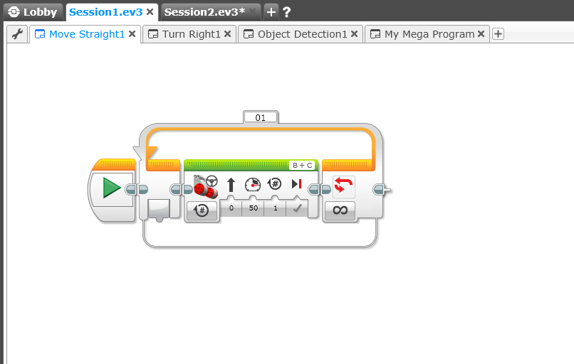
Challenge #1: Go Straight
Move Tank
Loop (forever)

Slide 7
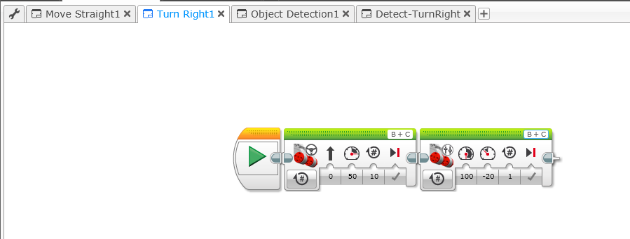
Challenge #2: Go Straight, Move Right
Left/Right Motor Controls
Move Tank

Slide 8
(optional) Challenge #2: Go Straight, Turn 180
Left/Right Motor Controls
Move Tank

Slide 9
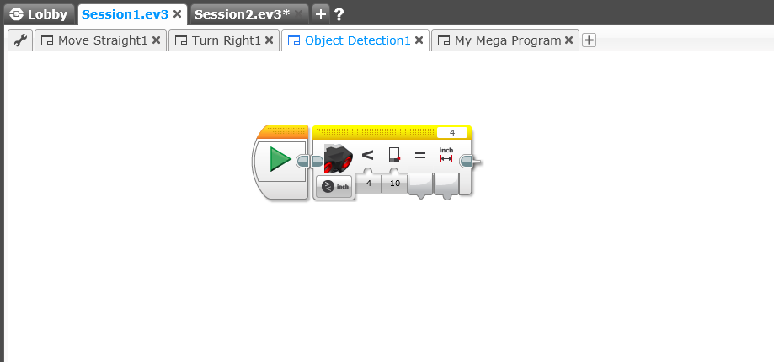
Challenge #3: Object Detection – (1)
Ultrasonic Sensor
Distance Detection
Controls

Slide 10
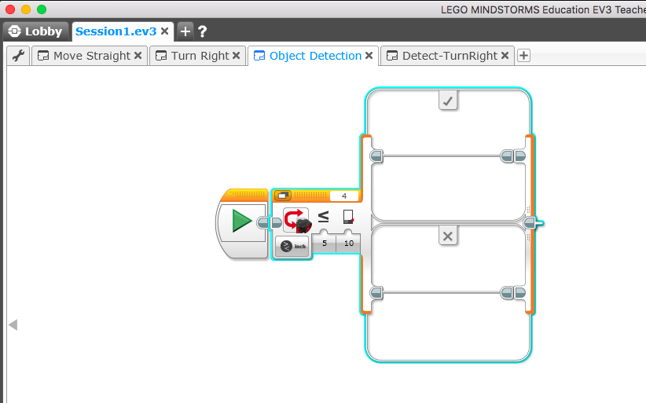
Challenge #4: Switch Block, Object Detection – (2)
Switch Block
If (condition = ‘Yes’)
Do this
Else
– Do that
Turn right (or 180)
Detect object
<=10 in?
Do nothing
Ultrasonic Sensor
Compare

Slide 11
Demo #1: Detect & Turn Right (Avoid) - Pseudocode
start
Move
straight
Detect object
<=10 in?
no
yes
Turn right (or 180)

Slide 12
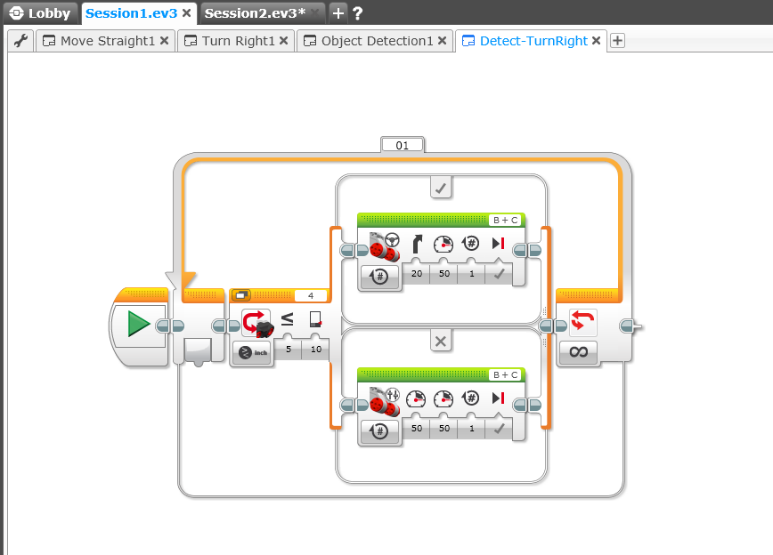
Demo #1: Detect Object & Turn Right (Avoid) - Code
If (object within 10 inches)
- Turn right
Turn right (or 180)
Detect object
<=10 in?
Go straight
Else
- Go straight
Ultrasonic Sensor

Slide 13
Demo #2: Detect & Avoid Object + Stay in Playpen
Option #1
start
Move
straight
Move
straight
Detect object
<=10 in?
Detect white border
?
no
no
yes
yes
Turn right (or 180)
Turn right (or 180)

Slide 14
Demo #2: Detect & Avoid Object + Stay in Playpen
Option #2
start
no
Move
straight
Detect white border
?
yes
Detect object
<=10 in?
no
yes
Turn right (or 180)

Slide 15
Demo #2: Detect & Avoid Object + Stay in Playpen
Option #3
start
Move
straight
Detect object
<=10 in?
no
no
Detect white border
?
yes
yes
Turn right (or 180)

Slide 16
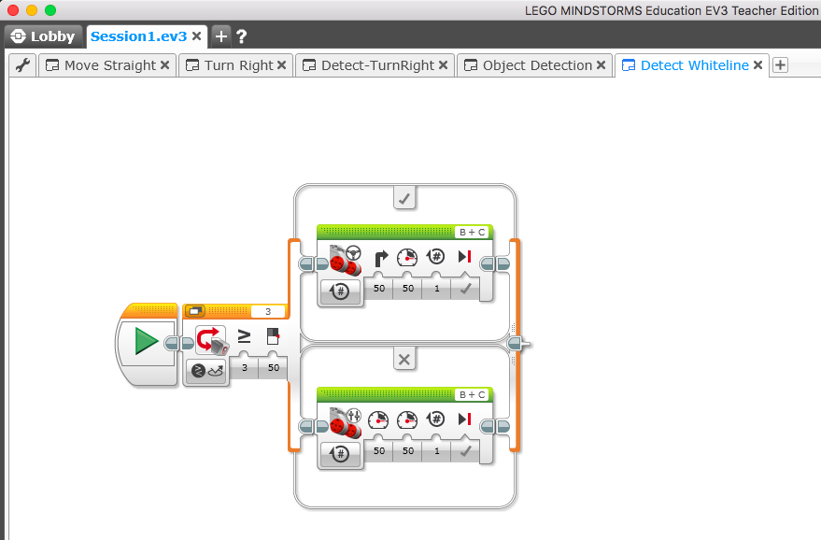
Demo #1: Detect Red line & Turn Right - Code
Turn right (or 180)
If (redline = ‘yes’)
- Turn right
Reflected intensity >=60?
Else
- Go straight
Go straight
Light Sensor
- Reflected light intensity

Slide 17
Demo Day
Goals
Avoid crashes
Stay within playpen
Move continuously
Learn & have fun!

